Slide 1
ADMINISTRACIÓN DE SERVICIOS PARA LA WEB
BRENDA GONZÁLEZ GÓMEZ bgonzaleztec@rlabservices.com

Slide 2
The Plan
What is Nagios Core?
Features & Benefits
Architecture
Installation & Configuration
Resources & Support
Get Involved
Questions
Notes:
2

Slide 3

What is...
The Standard in Open Source IT Monitoring
A monitoring and alerting engine
Notes:
3

Slide 4
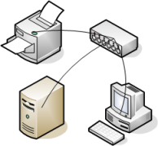


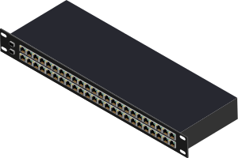


Comprehensive Monitoring
A few 'Nagiosable' things
    System metrics
    Service status
    Applications
    Network devices
Notes:
4

Slide 5
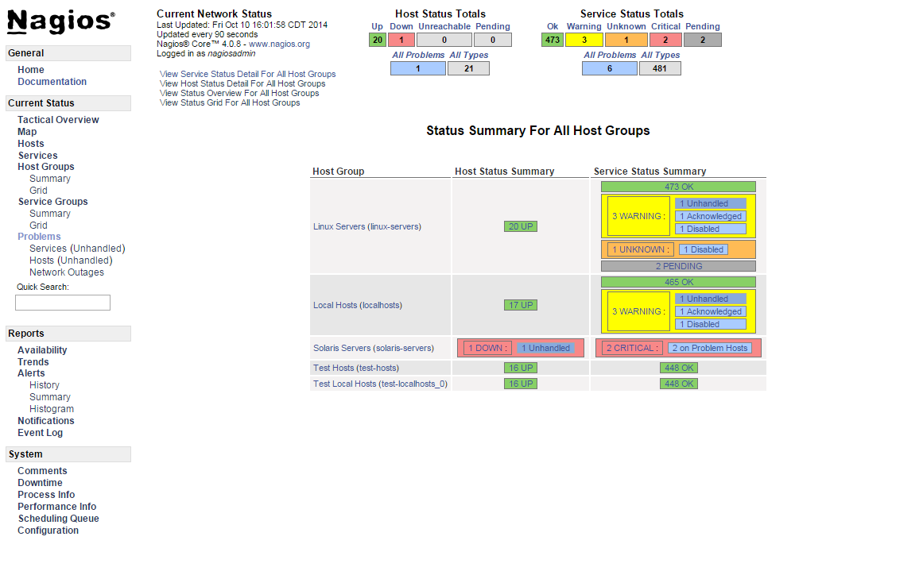
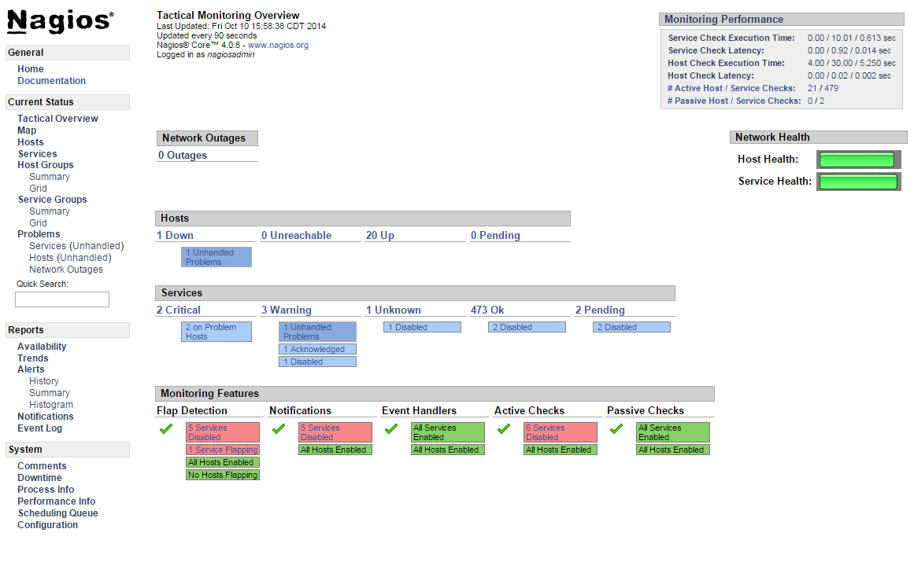
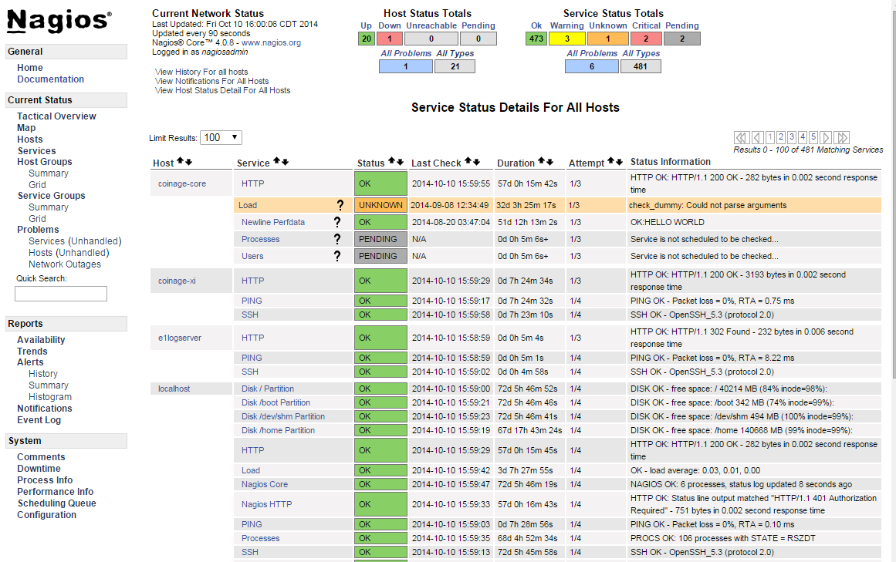
Visibility
Notes:
5

Slide 6


Alerting & Awareness
Multiple methods
      email, SMS, ...
      Customizable
      Targetable
      Escalations for multi-user setups
      Schedule downtime, avoid false alerts
Notes:
6

Slide 7

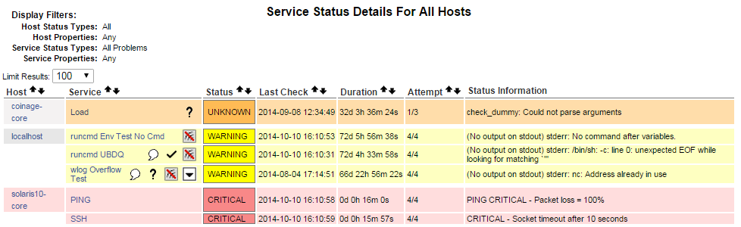
Problem Remediation
Acknowledge problems online
Event handlers for automation
Notes:
7

Slide 8
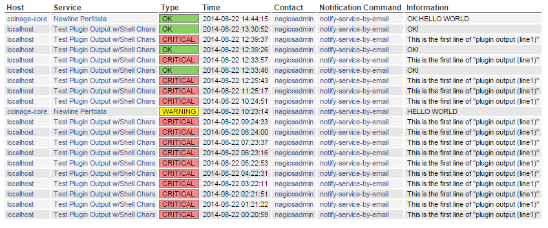
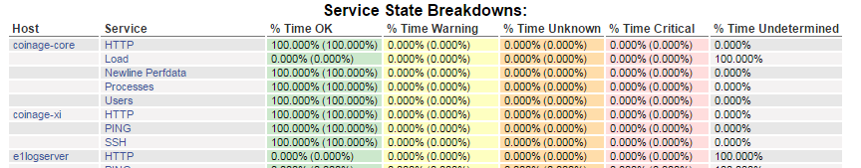
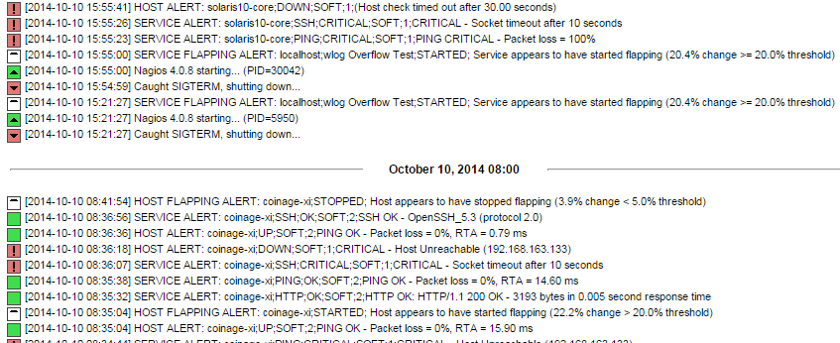
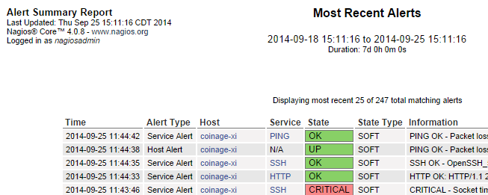
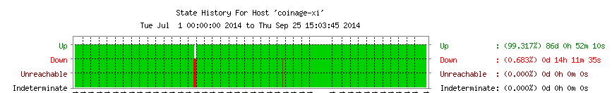
Reporting
Notes:
8

Slide 9
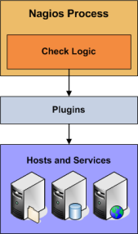
Extendable Architecture
List of 'objects' to monitor
Schedule of things to do
Run checks, other commands
Other work as requested
Notes:
9

Slide 10
Objects
Hosts & Host Groups
Services & Service Groups
Contacts & Contact Groups
Commands
Time Periods
Notification Escalations
Notification and Execution Dependencies
Notes:
10

Slide 11
Checks
Active
          Initiated by Nagios process
          Regularly scheduled
          On demand
  Passive
          Initiated externally
          Results sent to Core
Notes:
11

Slide 12
Formats & APIs
Configurable commands
Plugin / check result format
Performance data
External commands
Query handler
Check results spool
CGIs, now with JSON
Notes:
12

Slide 13
NEBs
Nagios Event Broker Modules
          Loaded into Core on startup
          Hook into key steps
          Can override or cancel some
Examples
        Distribute checks: mod_gearman
        Export data: NDOUtils
Notes:
13

Slide 14
ADVANTAGES
Open Source
Robust and Reliable
Highly Configurable
Easily Extensible
Active Development
Active Community
Nagios runs on many Operating System Nagios can be used to monitor all sorts of things.

Slide 15
BASICS OF NAGIOS
Nagios is split into two categories of objects:
  Hosts
    servers,
    routers,
    workstations,
    printers,
    and so on
  Services
    Secure Shell (SSH) server (sshd process on the machine)
uses four distinct states:
  Ok, Warning, Critical, and Unknown
Notes:
Hosts represent a physical or virtual device on your network (servers, routers, workstations, printers, and so on). Services are particular functionalities, for example, a Secure Shell (SSH) server (sshd process on the machine) can be defined as a service to be monitored. Each service is associated with a host on which it is running. In addition, machines can be grouped into host groups.

Slide 16
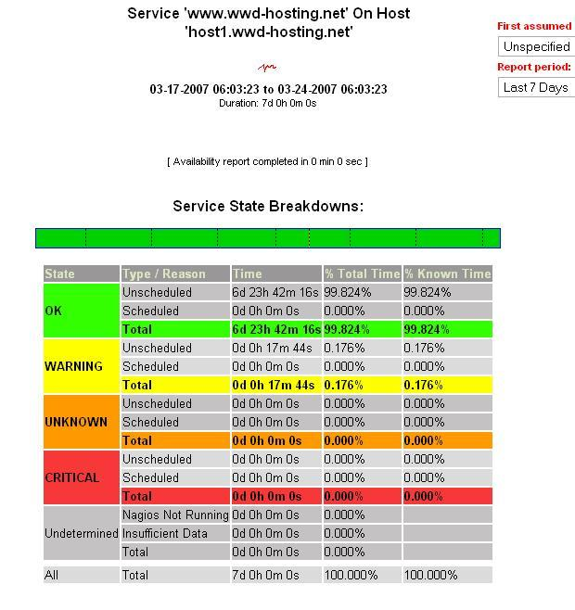
BASICS OF NAGIOS
Reports:
  X services are up and running,
  Y are in warning state,
  and Z are currently critical,
Notes:
which is much more readable than a matrix of values. It saves you the time of analyzing what's working and what's failing. It can also help prioritize what needs to be handled first, and which problems can be handled later.

Slide 17

That's Nice, but...
...how do I get started?
Notes:
17

Slide 18
Installation - 'Soft' Requirements
UNIX OS: Linux, BSD, OS X, Solaris, AIX, …
C compiler & development tools
Web server, PHP, gd (CGIs)
Network access
Notes:
18

Slide 19
Installation - 'Hard' Requirements
General Monitoring
Depends on rate and type of checks
 | Minimum | Recommended
Processor | 1 GHz | 2 GHz+
Memory | 512 MB | 1 GB+
Storage | 512 MB | 2 GB+
Notes:
19

Slide 20
Installation - Before We Begin...
WARNING: Comand Line Follows!
It doesn't last forever
Let's install Core on CentOS 6.5 Minimal
Notes:
20

Slide 21
Installation - Prerequisites
# Install dependencies for Core and popular plugins
yum install -y autoconf automake gcc glibc glibc-common make wget \
fping bind-utils net-snmp net-snmp-utils perl-Net-SNMP samba-client \
openssl-devel openssh-devel mysql-devel gettext gd gd-devel httpd php
# Setup users and groups
groupadd nagcmd
useradd nagios -s /sbin/nologin -M -d /usr/local/nagios/ -U -G nagcmd
usermod -a -G nagcmd apache
usermod -a -G nagios apache
Notes:
21

Slide 22
Installation - Nagios Plugins
Official collection of common plugins
    nagios-plugins.org
# Get the Nagios Plugins source code
cd /tmp
wget http://nagios-plugins.org/download/nagios-plugins-2.0.3.tar.gz
tar xzvf nagios-plugins-2.0.3.tar.gz
cd nagios-plugins-2.0.3
# Build and install the plugins
./tools/setup
./configure --with-nagios-user=nagios --with-nagios-group=nagios
make && make install
Notes:
22

Slide 23
Installation - Nagios Core
# Get the Nagios Core source code
cd /tmp
wget http://prdownloads.sourceforge.net/sourceforge/nagios/nagios-4.1.1.tar.gz
tar xzvf nagios-4.0.8.tar.gz
cd nagios-4.0.8
# Build and Install Nagios Core
./configure --with-command-group=nagcmd --with-nagios-group=nagios
make all
make install install-init
make install-config
make install-commandmode
make install-webconf
# Setup credentials for accessing the web backend.
sudo -u nagios htpasswd -c /usr/local/nagios/etc/htpasswd.users nagiosadmin
Notes:
23

Slide 24
Installation - System Setup
# SELinux is enforcing by default on CentOS. Disable it for this example.
setenforce 0
# Open up ports for HTTP. We use -I to insert the new rules at the head of
# the INPUT chain; -A adds them at the tail, possibly after a REJECT rule.
iptables -I INPUT -m state --state NEW -m tcp -p tcp --dport 80 -j ACCEPT
service iptables save
# Now (re)start our services to use the new configuration.
service httpd restart
service nagios start
# Have our services start automatically.
chkconfig nagios on
chkconfig httpd on
Notes:
24

Slide 25
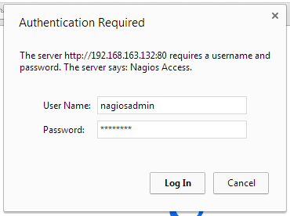
Installation - Try It Out
Notes:
25

Slide 26
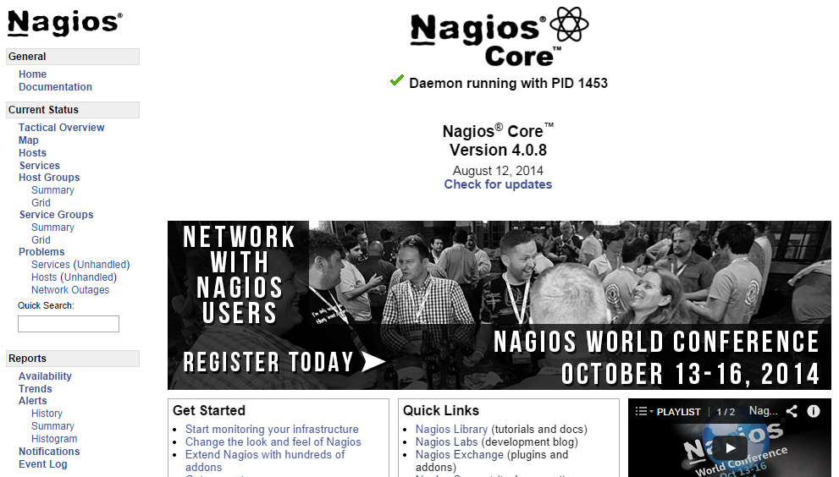
Installation - Try It Out
Notes:
26

Slide 27
Anatomy of an Installation
/usr/local/nagios/
  bin/ - Nagios Core binaries
  etc/ - Configuration files
  libexec/ - Plugins, event handlers, cmds
  sbin/ - CGI binaries
  share/ - Web UI files
  var/ - Runtime files, data, logs
Notes:
Click to add notes
27

Slide 28
etc/nagios.cfg
General program settings
  File paths
  NEBs to load
Loading other configuration
# You can specify individual config files:
cfg_file=/usr/local/nagios/etc/objects/commands.cfg
cfg_file=/usr/local/nagios/etc/objects/contacts.cfg
cfg_file=/usr/local/nagios/etc/objects/timeperiods.cfg
cfg_file=/usr/local/nagios/etc/objects/templates.cfg
# Configuration for multiple hosts:
cfg_dir=/usr/local/nagios/etc/hosts
Notes:
28

Slide 29
Configuration Basics
Basic format
define someobjecttype {
some_variable Some text
another_variable 1234
}
Notes:
29

Slide 30
A Partial Template Example
Template
define host {
use host_template
host_name example-host
alias Partial Host Example
host_address 127.0.0.1
}
Host
define host {
check_command check-host-alive
notification_options d,u,r
max_check_attempts 5
name host_template
register 0
}
Notes:
30

Slide 31
A Real Host Template
define host {
name generic-host ; Name of this host template
notifications_enabled 1 ; Host notifications are enabled
event_handler_enabled 1 ; Host event handler is enabled
flap_detection_enabled 1 ; Flap detection is enabled
process_perf_data 1 ; Process performance data
retain_status_information 1 ; Keep status info across restarts
retain_nonstatus_information 1 ; Keep non-status info across restarts
notification_period 24x7 ; Send host notifications at any time
register 0 ; Don't register, this is a template!
}
Notes:
31

Slide 32
More configuration
Where to from here?
Sample config: etc/
Experiment
Core Manual
nagios.sourceforge.net/docs/nagioscore/4/en/toc.html
Notes:
32

Slide 33
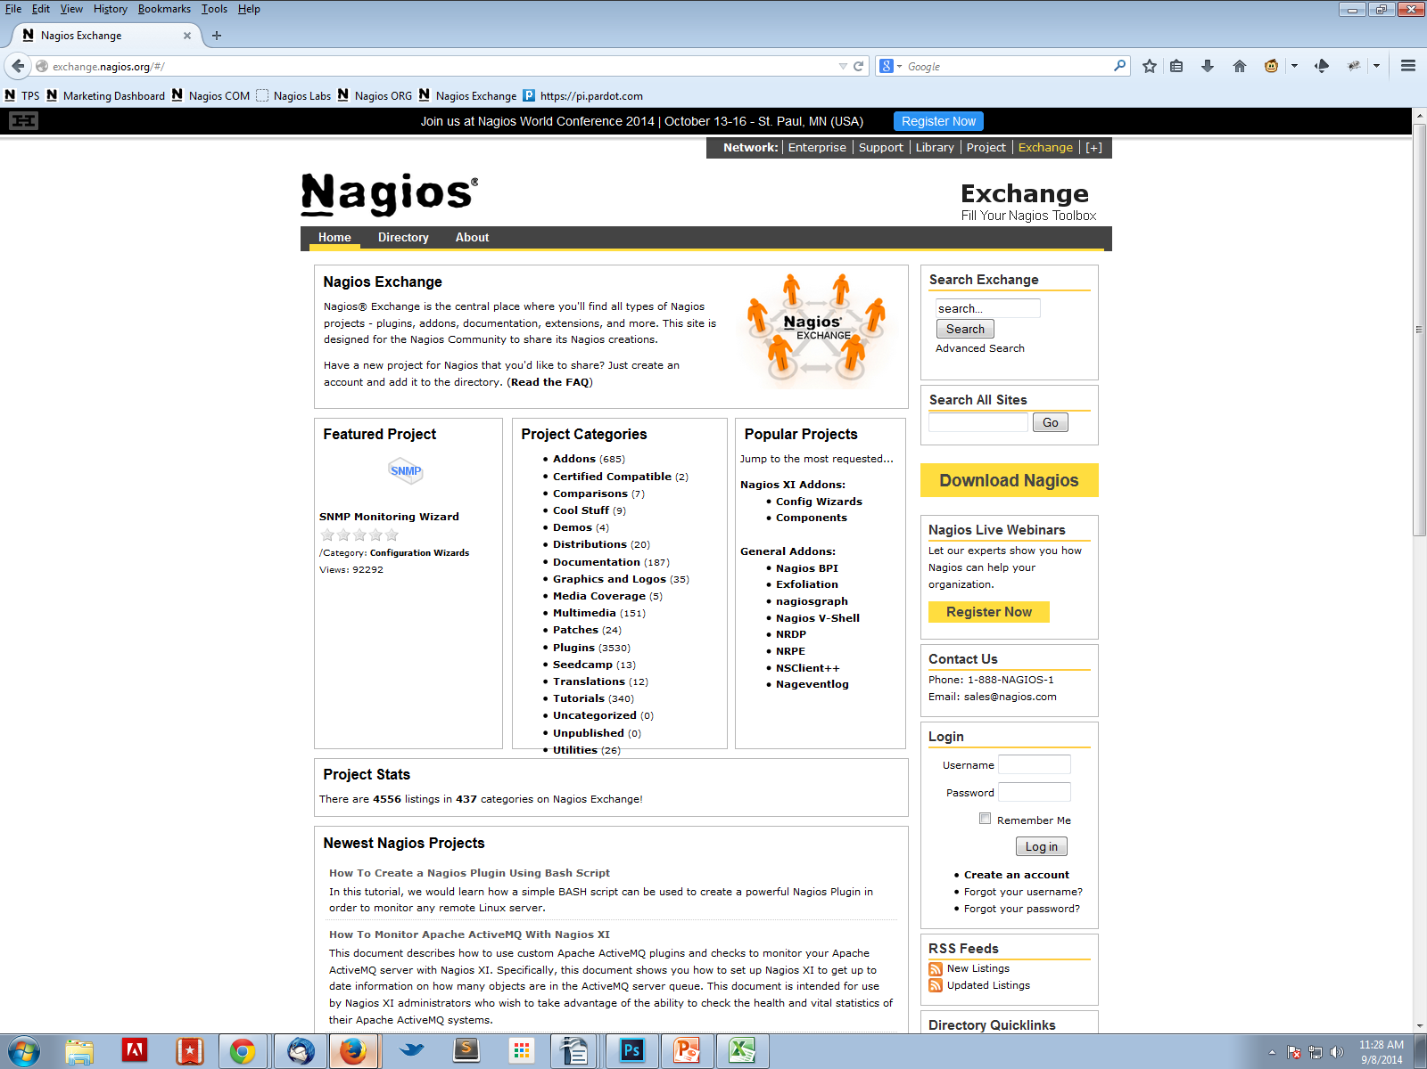
Nagios Exchange
exchange.nagios.org
Notes:
33

Slide 34
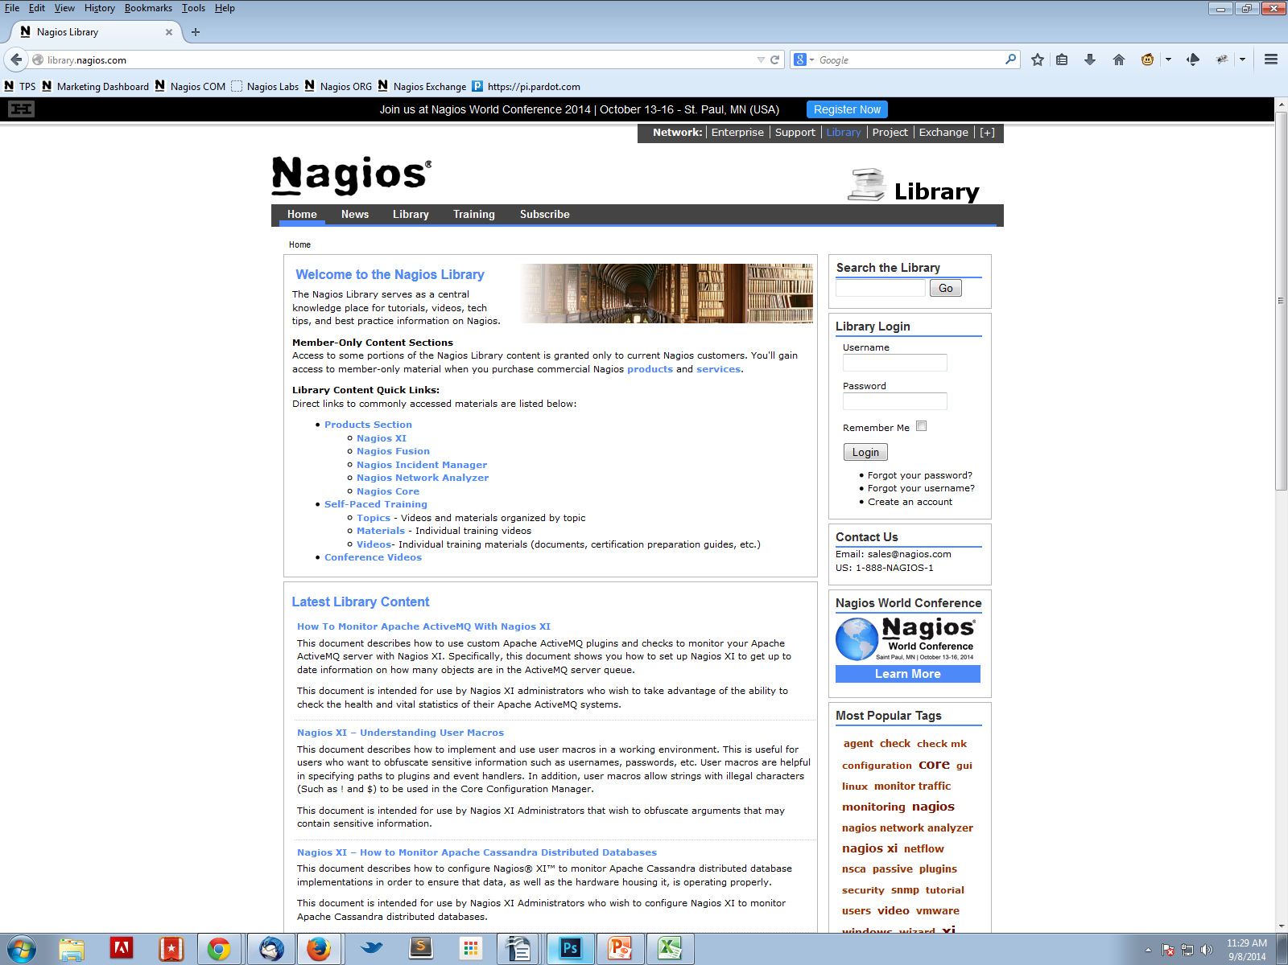
Nagios Library
library.nagios.com
Notes:
34

Slide 35
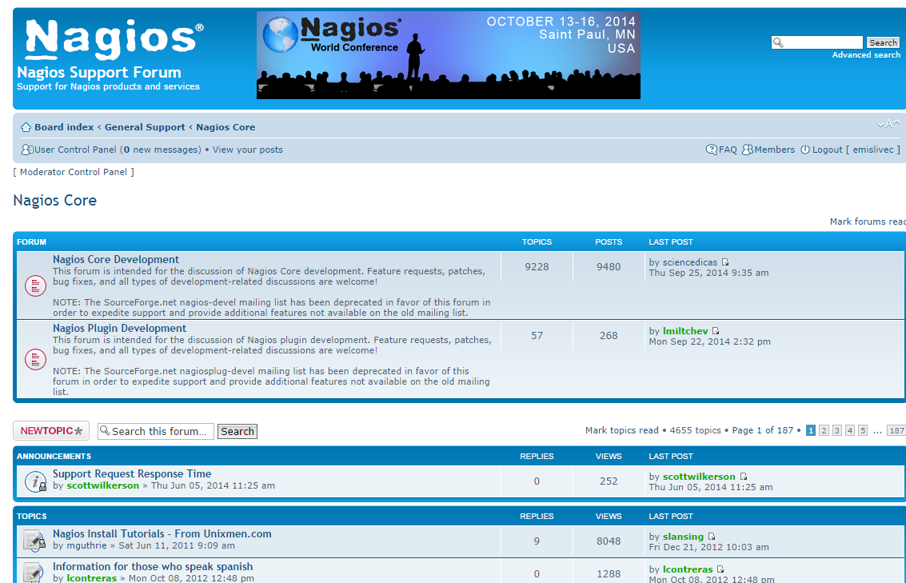
General Support Forum
support.nagios.com/forum
Notes:
35

Slide 36
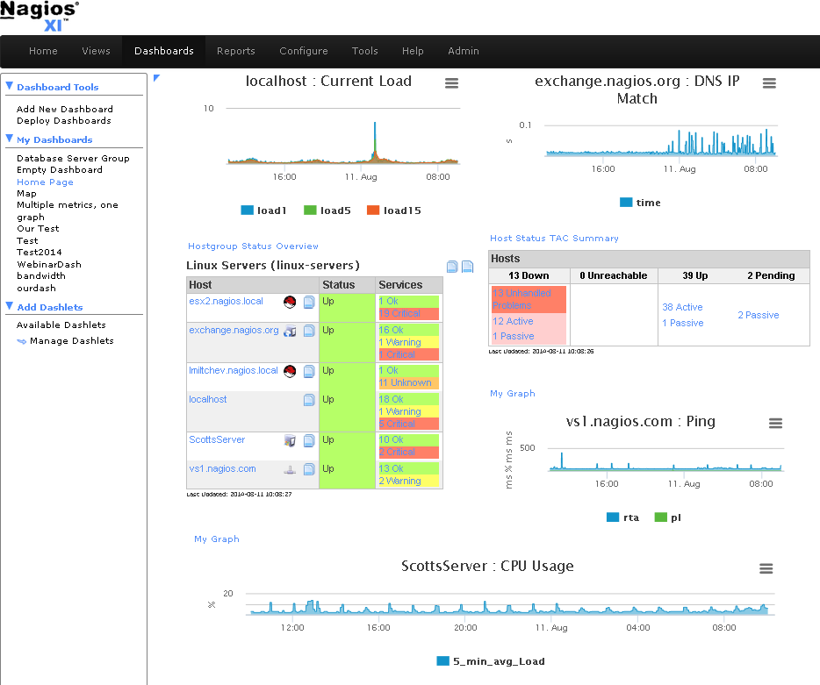
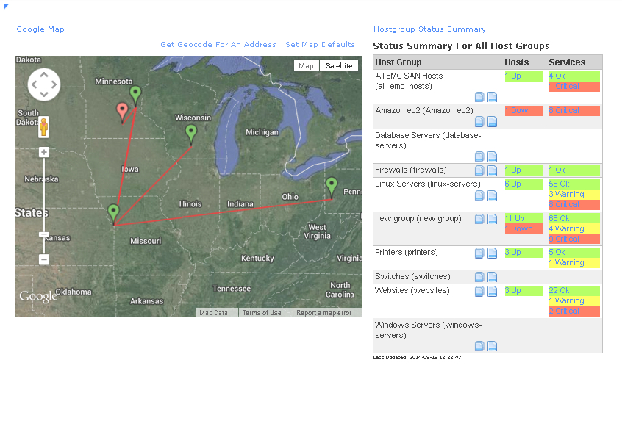
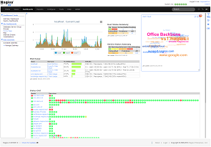
Nagios XI
nagios.com/products/nagiosxi
Notes:
36

Slide 37
Get Involved
Learn, share and help on the forums
support.nagios.com/forum
Share on Exchange
exchange.nagios.org
We're on GitHub
github.com/NagiosEnterprises
github.com/NagiosEnterprises/nagioscore
Notes:
37

Slide 38
Summary
Enables comprehensive monitoring
Awarness, visibility, resolution, reporting
Extensible architecture
Installation
Introduction to configuration concepts
Where to find more resources
How to contribute
Notes:
38

